Slide 1
Listing multiples
Properties of number: factors, multiples, squares and cubes

Slide 2
how to use Oak lessons

Slide 3
I can state what a multiple is and can list multiples and common multiples of two or more numbers.

Slide 4
A multiple is the product of a number and an integer.

Slide 5
A common multiple is a number that is a multiple of two or more numbers.

Slide 6

Listing multiples
Listing multiples
Common multiples
Using common multiples to compare fractions

Slide 7
Listing multiples
There are lots of different ways to list a multiple of a number.
Example
List the first six multiples of 5
5
, 10
, 15
, 20
, 25
and 30
Using an array

Slide 8

Listing multiples
There are lots of different ways to list a multiple of a number.
Example
List the first six multiples of 5
5
, 10
, 15
, 20
, 25
and 30
+5
+5
+5
+5
+5
by
counting on
5
10
15
20
25
30

Slide 9
Listing multiples
There are lots of different ways to list a multiple of a number.
Example
List the first six multiples of 5
5
, 10
, 15
, 20
, 25
and 30
✖ | 1 | 2 | 3 | 4 | 5 | 6
1 | 1 | 2 | 3 | 4 | 5 | 6
2 | 2 | 4 | 6 | 8 | 10 | 12
3 | 3 | 6 | 9 | 12 | 15 | 18
4 | 4 | 8 | 12 | 16 | 20 | 24
5 | 5 | 10 | 15 | 20 | 25 | 30
6 | 6 | 12 | 18 | 24 | 30 | 36
Using
a multiplication table

Slide 10
Listing multiples
There are lots of different ways to list a multiple of a number.
Example
List the first six multiples of 5
5
, 10
, 15
, 20
, 25
and 30
5
5 ✕ 1 =
Using products
10
5 ✕ 2 =
15
5 ✕ 3 =
20
5 ✕ 4 =
25
5 ✕ 5 =
30
5 ✕ 6 =

Slide 11

Listing multiples
Which of the following set of numbers are the first six multiples of 8? Explain what the other sets of numbers represent.
These are the first six multiples of 6
These are factors of 8
These are multiples of 8, but not the first 6
6, 12, 18, 24, 30, 36
1, 8, 2, 4
8, 80, 800, 8000, 80 000, 800 000
8, 16, 24, 32, 40, 48

Slide 12
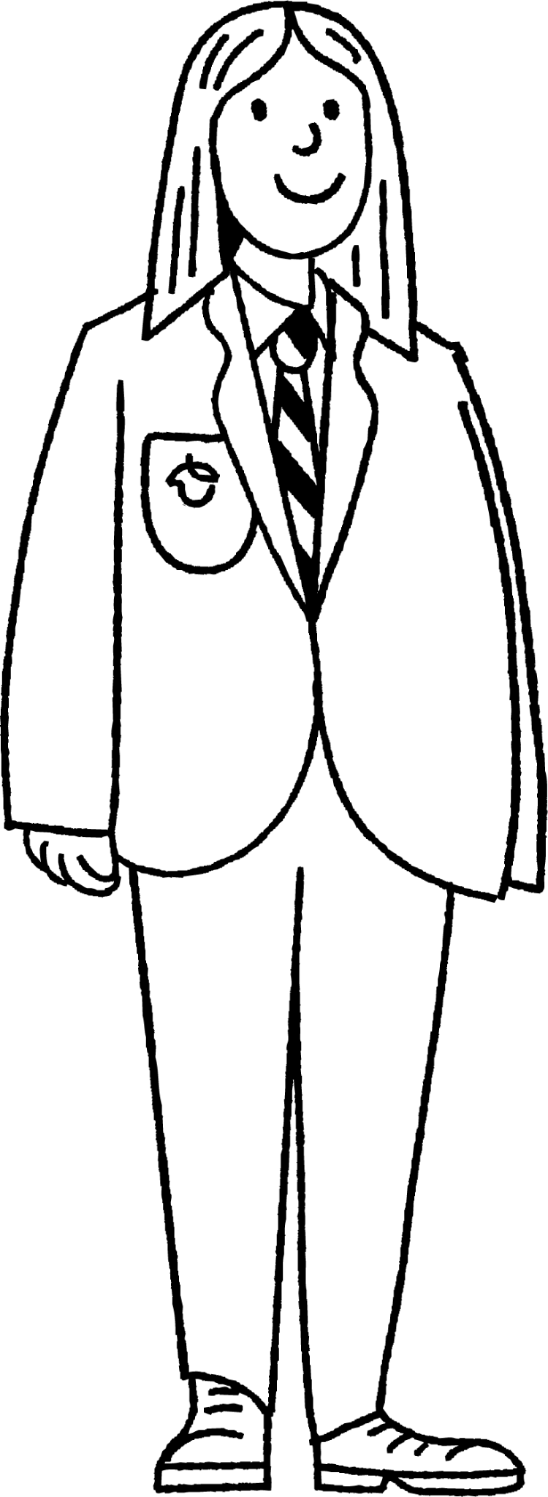
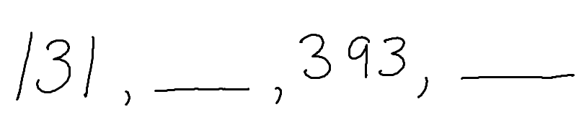
Listing multiples
Laura wrote a list of consecutive multiples
Can you work out the missing multiples?
262
524
Laura

Slide 13


Listing multiples
List the first five multiples of:
8
10
12
15
2) Alex says
Is Alex correct? Explain your answer
30 is a multiple of 4 because 4 ✕ 7.5 = 30

Slide 14





Listing multiples
3) Jacob started listing the first multiples of some numbers. He then spilled ink all over his work.
Find the multiples Jacob was working out and the missing numbers.
Multiples of 111 :
111, , , 444, 555, …
, 46, , 92, 115, …
324, , , , 1620, …
, , , , 4225, …
b) Multiples of :
c) Multiples of 324 :
d) Multiples of :

Slide 15
Listing multiples
List the first five multiples of:
8
10
12
15
8, 16, 24, 32, 40
10, 20, 30, 40, 50
12, 24, 36, 48, 60
15, 30, 45, 60, 75
2) Alex says
Is Alex correct? Explain your answer
30 is a multiple of 4 because 4 ✕ 7.5 = 30
No, 4 has not been multiplied by an integer.

Slide 16

Listing multiples
3) Jacob started listing the first multiples of some numbers. He then spilled ink all over his work.
Find the multiples Jacob was working out and the missing numbers.
Multiples of 111 :
222
333
111, , , 444, 555, …
, 46, , 92, 115, …
324, , , , 1620, …
, , , , 4225, …
b) Multiples of :
23
23
69
c) Multiples of 324 :
648
972
1296
845
d) Multiples of :
845
1690
2535
3380

Slide 17
Listing multiples
Listing multiples
Common multiples
Using common multiples to compare fractions

Slide 18
Common multiples
A common multiple is number that is a multiple of two or more numbers.
Example
List the first ten multiples of 3 :
3, 6, 9, 12, 15, 18, 21, 24, 27, 30
List the first ten multiples of 4 :
4, 8, 12, 16, 20, 24, 28, 32, 38, 40
Can you see the common multiples?
12 and 24

Slide 19

Common multiples
Jun lists the multiples of 8 and 7.
There are no common multiples of 8 and 7
Multiples of 8 : 8, 16, 24, 32, 40, 48, …
Multiples of 7 : 7, 14, 21, 28, 35, 42, 47, …
Is Jun correct? Explain
Jun is incorrect. He needed to continue listing the multiples and he would have found 56 is the first common multiple of 7 and 8. There are also an infinite number of common multiples.

Slide 20
Common multiples
List all the common multiples of 3 and 5 that are less than 50
List all the common multiples of 6 and 4 that are less than 50
Multiples of 3 : 3, 6, 9, 12, 15, 18, 21, 24, 27, 30, 33, 36, 39, 42, 45, 48
Multiples of 4 : 4, 8, 12, 16, 20, 24, 28, 32, 36, 40, 48
Multiples of 5 : 5, 10, 15, 20, 25, 30, 35, 40, 45
Multiples of 6 : 6, 12, 18, 24, 30, 36, 42, 48
Common multiples are 15, 30 and 45
Common multiples are 12, 24, 36 and 48

Slide 21
Common multiples
Find all the common multiples of 7 and 5 which are less than 100.
Find all the common multiples of 5, 8 and 10 which are less than 100.

Slide 22
Common multiples
3) Using the numbers, fill in the missing gaps. You can only use each number once.
5
6
9
10
12
12
27
27
50
is a common multiple of and
is a common multiple of and
is a common multiple of and

Slide 23



Common multiples
4) A path is made up from 100 steps, numbered 1 to 100.
Robot A steps on every 8th step.
Robot B steps on every 3rd step.
Robot C steps on every 6th step.
a) Which numbered steps will all three robots have stepped on?
b) Robot D steps on every 2nd step. Will this change your answer to part a? Explain why.

Slide 24
Common multiples
Find all the common multiples of 7 and 5 which are less than 100.
Find all the common multiples of 5, 8 and 10 which are less than 100.
Common multiples: 35 and 70
Common multiples: 40 and 80

Slide 25
Common multiples
3) Using the numbers, fill in the missing gaps. You can only use each number once.
5
6
9
10
12
12
27
27
50
12
6
12
is a common multiple of and
is a common multiple of and
is a common multiple of and
50
5
10
27
27
9

Slide 26
Common multiples
4) A path is made up from 100 steps, numbered 1 to 100.
Robot A steps on every 8th step.
Robot B steps on every 3rd step.
Robot C steps on every 6th step.
a) Which numbered steps will all three robots have stepped on?
24, 48 and 72
b) Robot D steps on every 2nd step. Will this change your answer to part a? Explain why.
No because multiples of 2 are also common multiples of 8 and 6 so it will make no difference.

Slide 27
Listing multiples
Listing multiples
Common multiples
Using common multiples to compare fractions

Slide 28
Using common multiples to compare fractions
We can use common multiples to compare fractions by writing the equivalent fraction where the denominator is the common multiple.
When there is a common denominator, we can make comparisons more easily.

Slide 29





Using common multiples to compare fractions
Sofia is a good tennis player. She generally wins 2 out of 3 games played.
Jacob is also a good tennis player. He generally wins 3 out of 5 games played.
Example
=
=
=
=
=
Who is the better tennis player? You must show your working out.
Sofia because if they both played 15 games, Sofia would win 10 and Jacob would win 9.

Slide 30


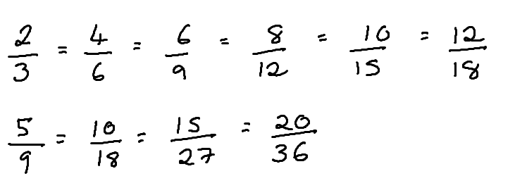



Using common multiples to compare fractions
Aisha does the following working out to find which fraction is smaller.
or
Which equivalent fractions should she use to compare?
Which fraction is the smallest fraction?
Aisha could have compared with
or
she could have compared and . The smaller fraction is .

Slide 31

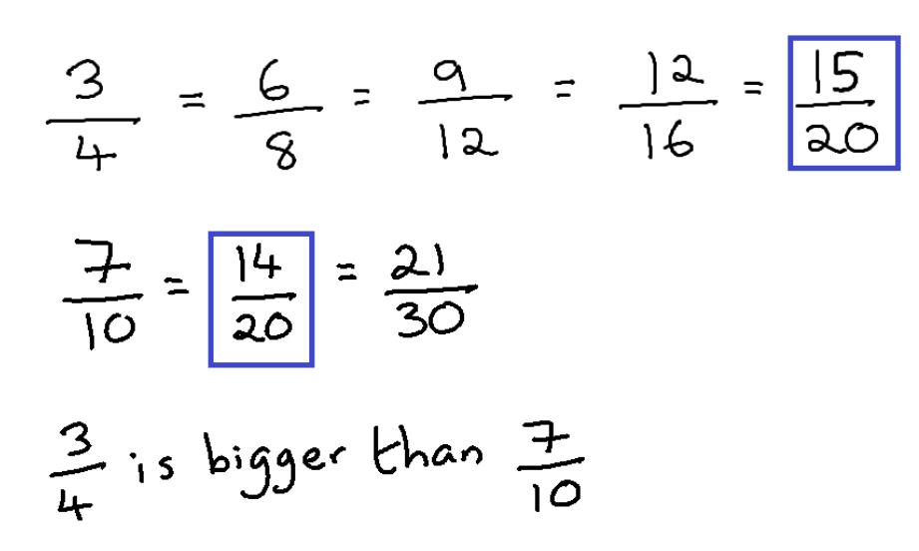
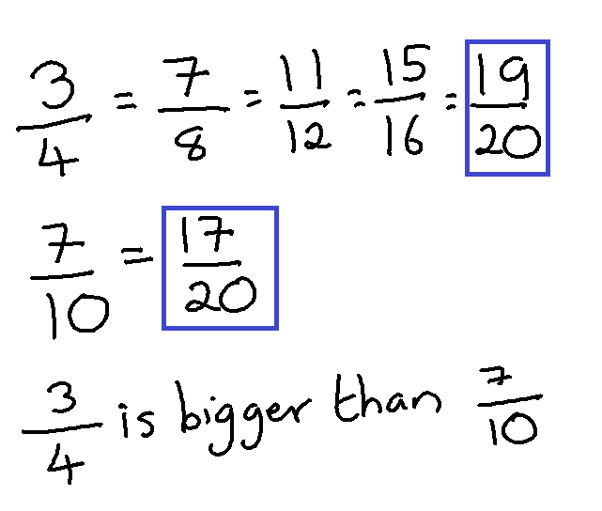


Using common multiples to compare fractions
Andeep is not writing equivalent fractions
Andeep compares and . Which is the correct working out? Explain.
a
b

Slide 32
Using common multiples to compare fractions
Using common multiples to compare fractions, identify the largest fraction. You must show your working out.
and
b) and
c) and

Slide 33


Using common multiples to compare fractions
2) Three students have the following success rates on a game.
WELL DONE SAM!
YOUR SUCCESS
RATE IS
WELL DONE LUCAS!
YOUR SUCCESS
RATE IS
WELL DONE ALEX!
YOUR SUCCESS
RATE IS
Who is the best player? You must show your working out.
State a fractional success rate in between Sam’s and Alex’s success rates.

Slide 34


Using common multiples to compare fractions
Using common multiples to compare fractions, identify the larger fraction in each pair below. You must show your working out.
and
b) and
c) and

Slide 35


Using common multiples to compare fractions
Using common multiples to compare fractions, identify the larger fraction in each pair below. You must show your working out.
and
b) and
c) and

Slide 36


Using common multiples to compare fractions
Using common multiples to compare fractions, identify the larger fraction in each pair below. You must show your working out.
and
b) and
c) and

Slide 37
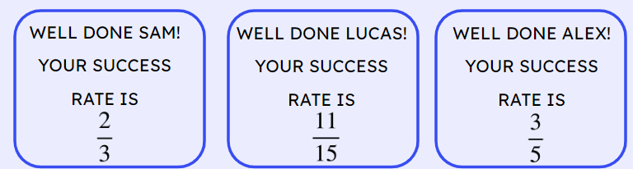



Using common multiples to compare fractions
Using common multiples to compare fractions
2) Three students have the following success rates on a game.
Who is the best player? You must show your working out.
Lucas
19
30
State a fractional success rate in between Sam’s and Alex’s success rates.

Slide 38
Listing multiples
A common multiple is a number that is a multiple of two or more numbers.
Common multiples can be found by listing multiples of each number and then identifying the common multiple from each list.
Common multiples can be used to compare fractions.

Slide 39

© Oak National Academy 2023.
Produced in partnership with Mathematics in Education and Industry.
Licensed on the Open Government Licence v3.0, except where otherwise stated. See Oak terms and conditions.

